Slide 1
Buyer Focused Home Price Estimation in Ames, Iowa
By Trevor Ban and Robert Lando

Slide 2
Outline
Problem and Goals
Wolliz competing with Zillow
Wolliz provides 2 features: Town at a Glance and Price Estimate
This presentation will demonstrate the backend for the interactivity of these 2 features
Town at a glance
Map out the town by presence of desired features
Price estimate
Outline most important features and interrelations
Conclusion
Moving forward
Thank you, you’re a wonderful audience!

Slide 3
Context
Users want a more customizable house searching platform. Wolliz seeks to remedy this need.
Wolliz is searching for engineers to perform the data analysis necessary to provide users with 2 customizable search features.
Using the Ames Iowa dataset as a testcase, what follows is a proof of concept for Wolliz.

Slide 4
Wolliz!
Provide users 2 primary features for real estate search
Town at a Glance
Price estimate based on preferred features

Slide 5
01
Town At A Glance
Provide the user with a brief overview of the town in question

Slide 6
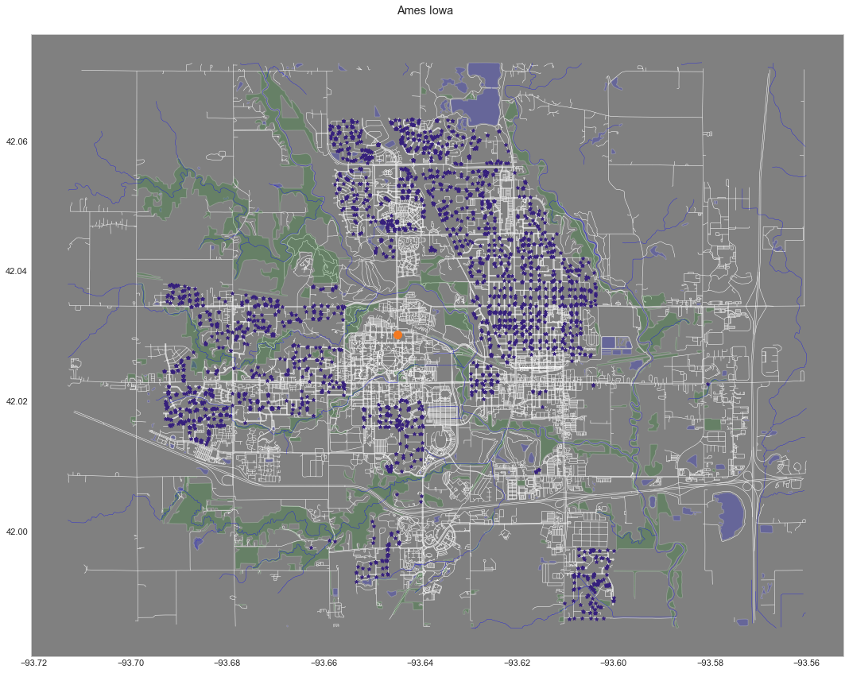

Slide 7
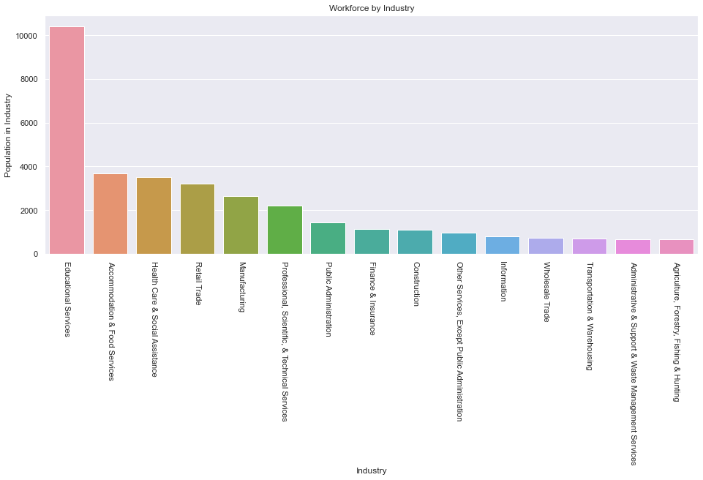
Source: https://datausa.io/profile/geo/ames-ia#about

Slide 8
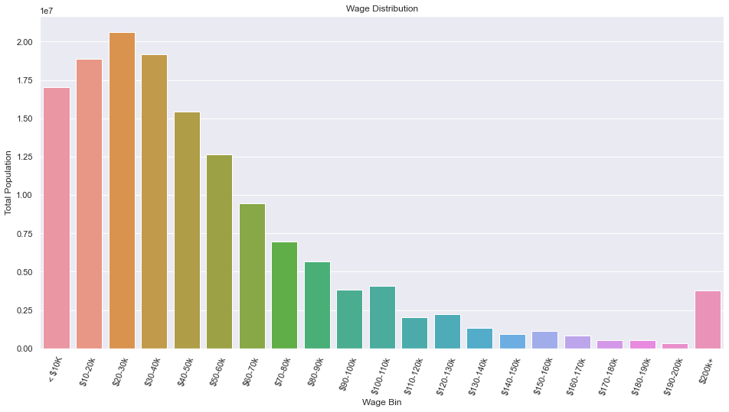
Source: https://datausa.io/profile/geo/ames-ia#about

Slide 9
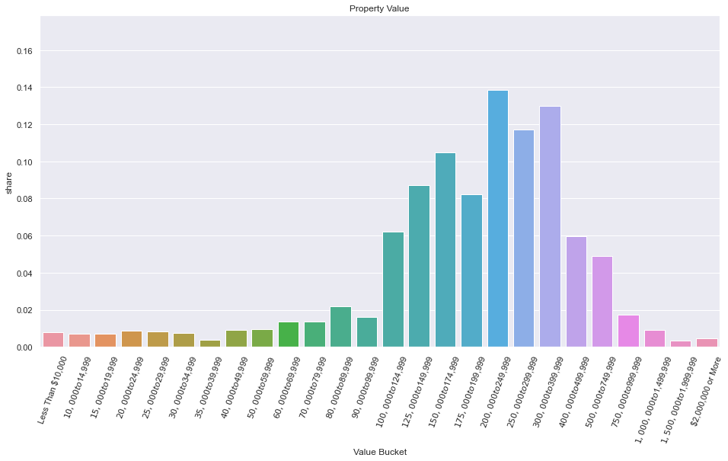
Source: https://datausa.io/profile/geo/ames-ia#about

Slide 10
Geographically Relevant Features
1
4
2
5
3
6
Year Built
Price/Square Foot
Sale Price
# Full Bathrooms
Neighborhood Median Sale Price
Overall Quality

Slide 11
Engineering Geo-features
Nearest Park
Nearest Large Park
Nearest Stream
Distance to ISU
Neighborhood Median…
Year Built
Sale Price
Total Square Footage

Slide 12
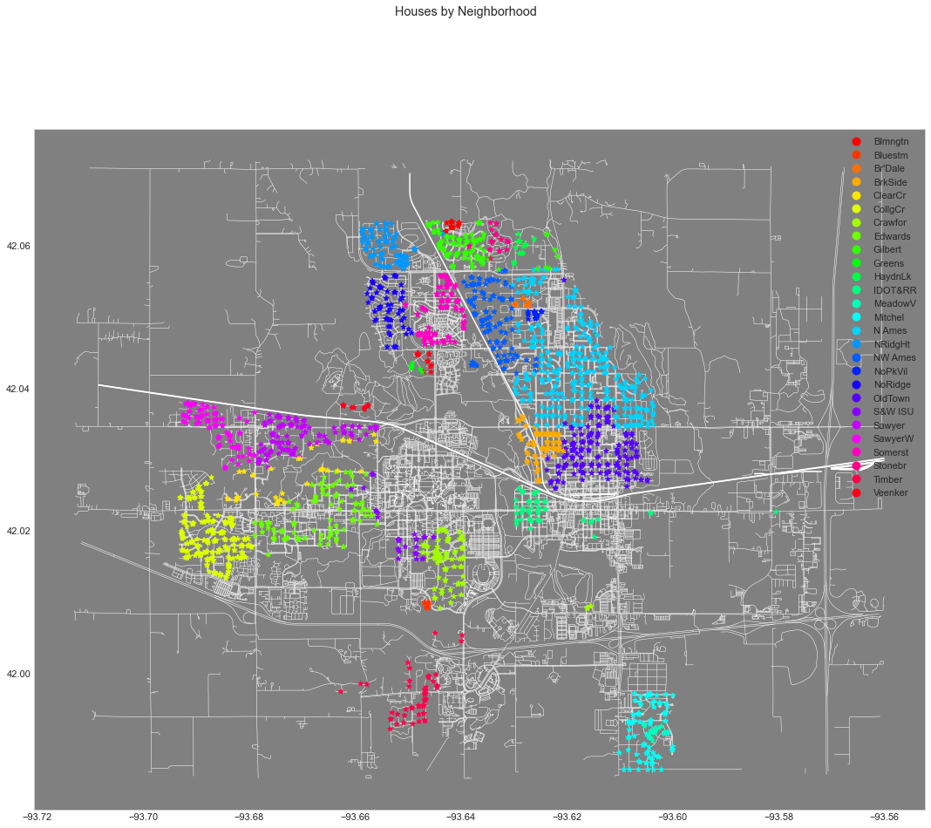

Slide 13
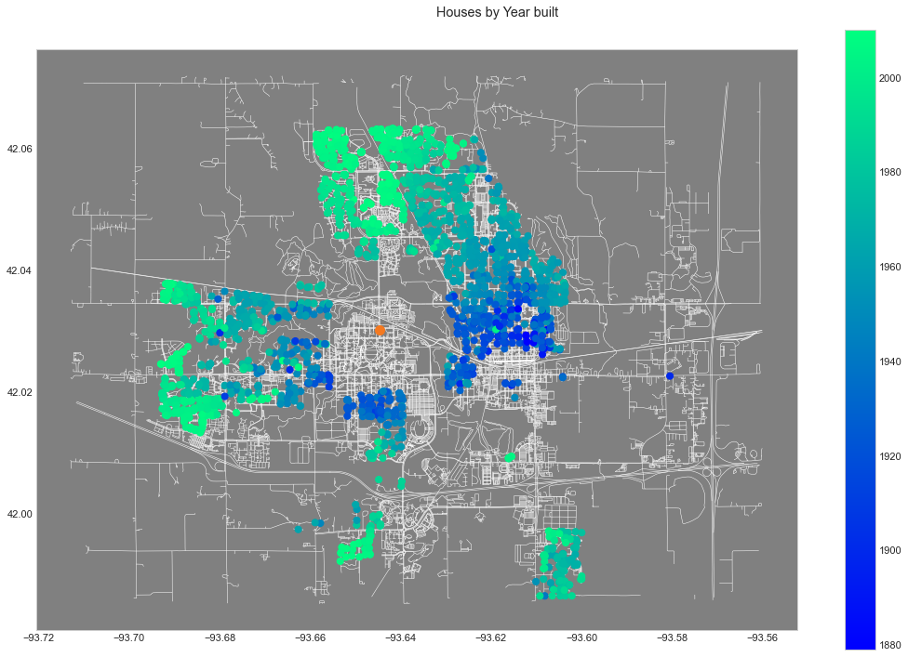

Slide 14
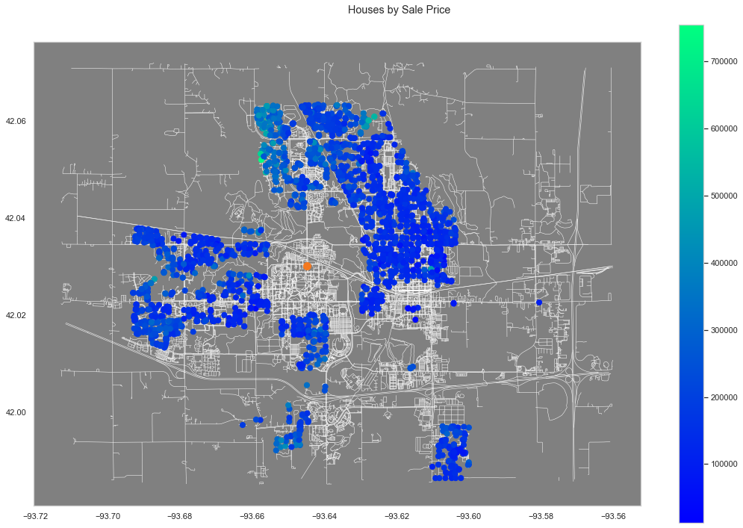

Slide 15
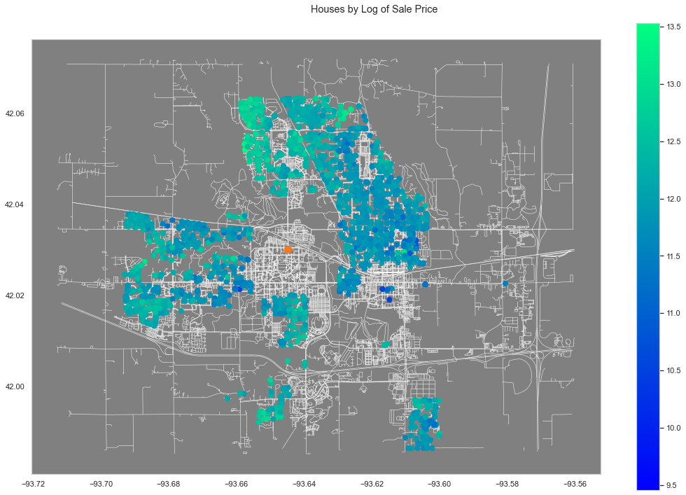

Slide 16
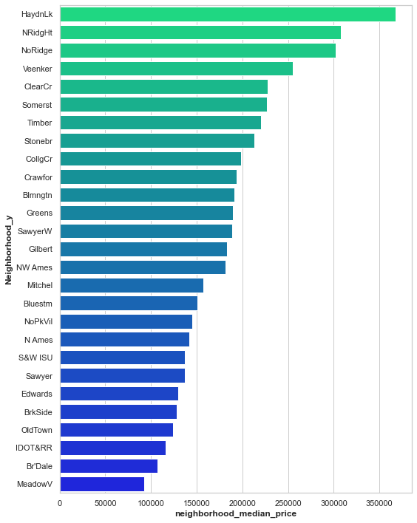
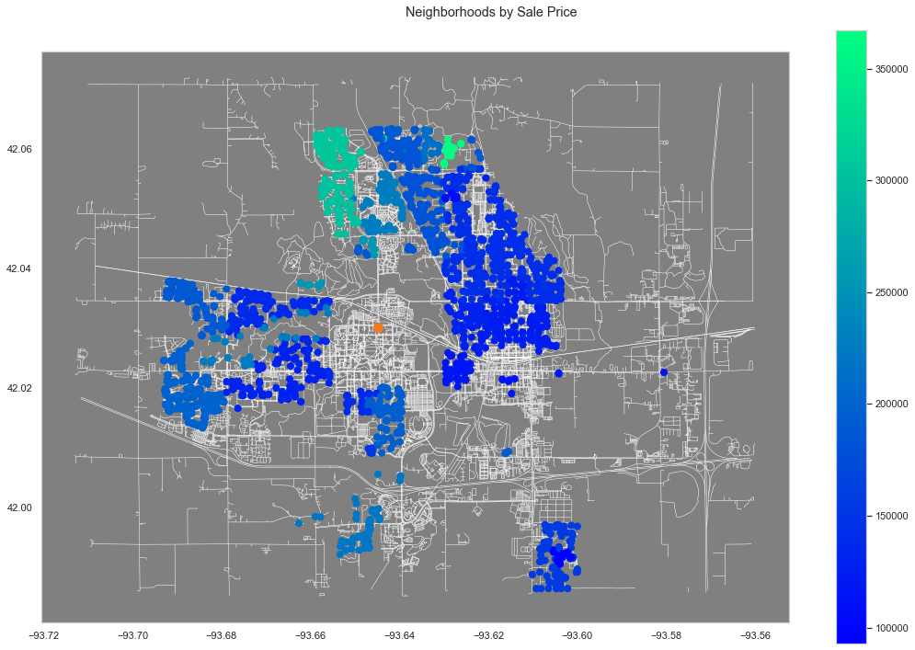
Median House Price by Neighborhood

Slide 17
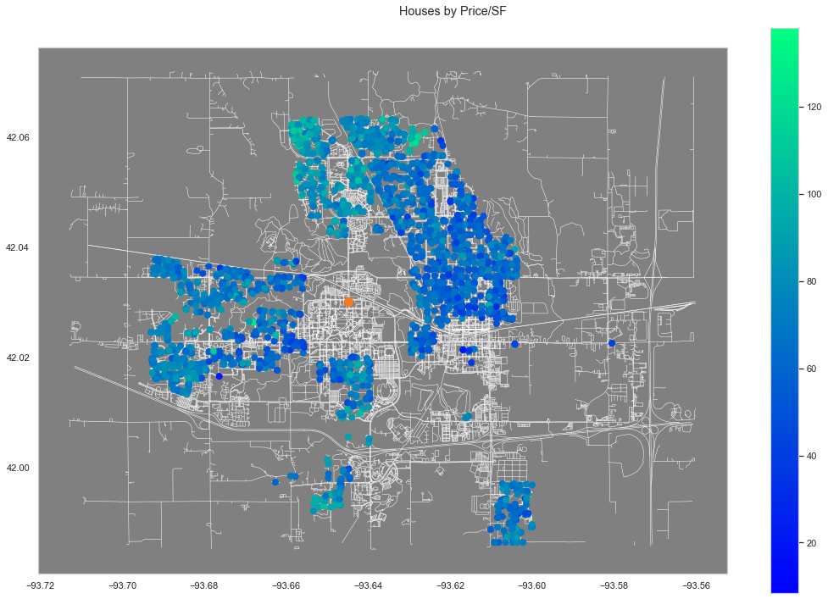

Slide 18


Slide 19
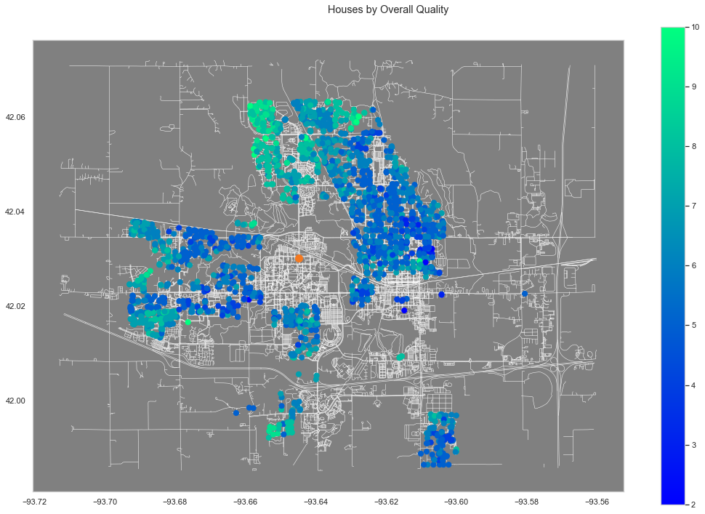

Slide 20
02
Price Estimate
Give the user a price estimate based on their stated feature preferences

Slide 21
Estimating Sale Price for Homes in Ames, Iowa.
2 datasets relevant to Ames, Iowa Housing Market.
Set 1: (Housing)
Various features of multiple homes within Ames + a unique location id number.
Associated sale prices with each home date within 2006-2010.
Set 2: (Real-Estate)
Overlapping features with Set 1 along with additional features like land value, tax info, address, etc.
Contained unique location id number related to set 1
Associated sale prices with each home date within 2017-2020

Slide 22
Feature Engineering:
(Target Log Sale Price)
Ordinal Categoricals
Nominal Categoricals
Other Features
Dummified and then reduced based on relationship with target variable.
ex.)
MSSubClass,MSZoning,
Neighborhood
ex.)
TotalSF,
Med Neighborhood Total SF,
SF Percent Unfinished,
Auxiliary SF (Pools Porches, Garage, etc…),
Relative SF measures,
Nearest Large Park,
Distance from ISU.
Imputed 1-n or 0-n
ex.)
Overall Quality, Basement Exposure, Basement Condition, External Condition,
Kitchen Quality.

Slide 23
Methodology
We wish to model home sale price as a function of physical properties (square footage, garage size, material quality, bathrooms, etc…) as well as geographic aspects (neighborhood, location relative to points of interest, etc…).
Given the immense amount of features available on each home, we preemptively place an emphasis on model simplicity and interpretability to start. Users will likely only state a handful of features that they want when using our estimation solution.
Therefore limiting potential inputs is preferred.
Accuracy can always be improved later on.
Highest priority is to understand what the most important predictive features associated with sale price are, and how they relate to sale price.

Slide 24
Feature Selection Methods
Naive Selection Solely by Correlation and Visual Trends
Random Forest Regression (Feature Importance)
Statistical Significance in Multiple Linear Regression or Huber Regression (P-Values)
Lasso Regression (Coefficients vs. Lambda)

Slide 25
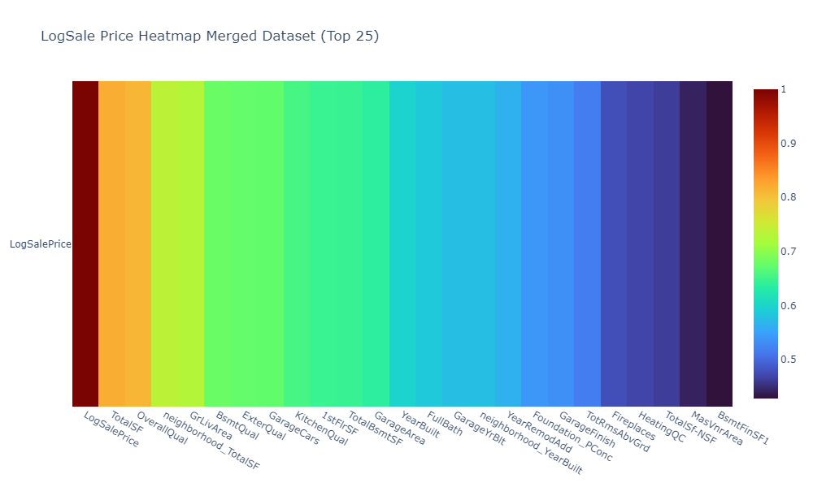
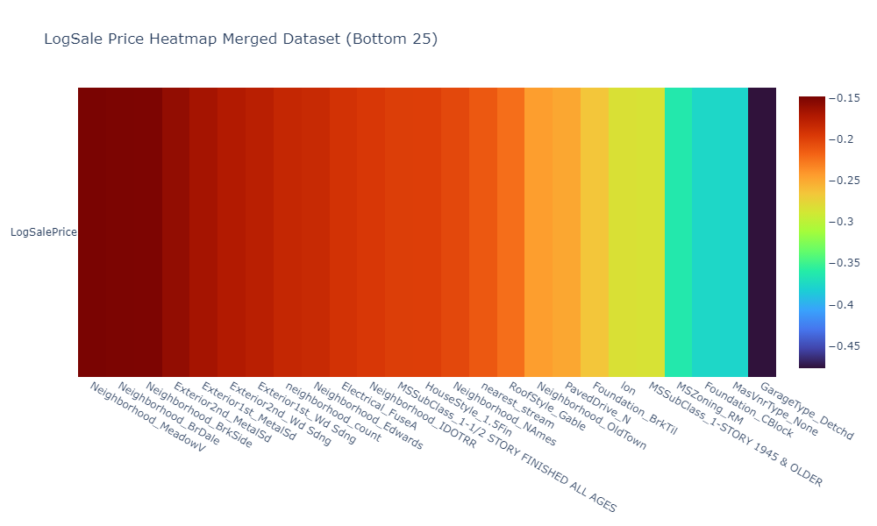
Correlations with LogSale Price

Slide 26
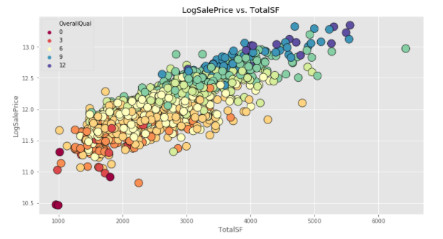
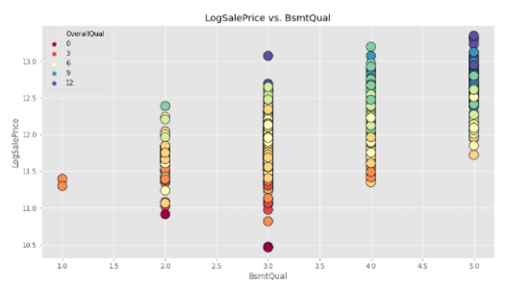
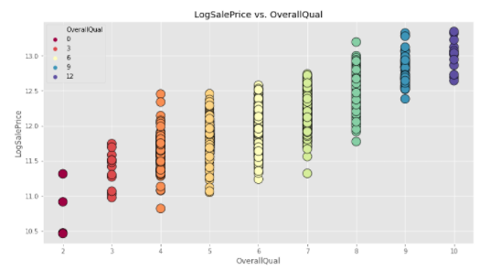
Trends

Slide 27
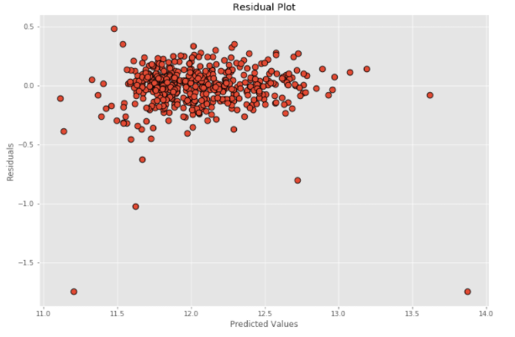
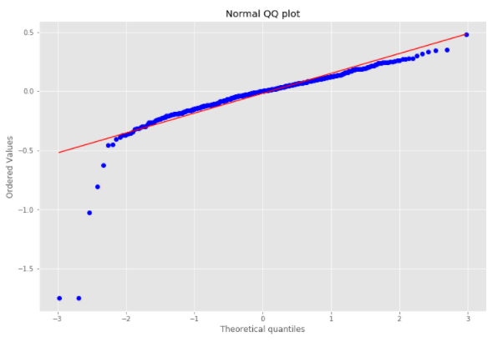
LogSalePrice ~ C0 + C1*TotalSF + C2*OverallQual + C3*BsmtQual
TotalSF: Total Square footage of a given home (basement sf + gross living area)
OverallQual: Rates the overall material and finish of the house.
BsmtQual: Evaluates the height of the basement.
Train R^2: .830
Test R^2: .773
C0 = 12
C1 = .175 (TotalSF)
C2 = .133 (OverallQual)
C3 = .069 (BsmtQual)

Slide 28
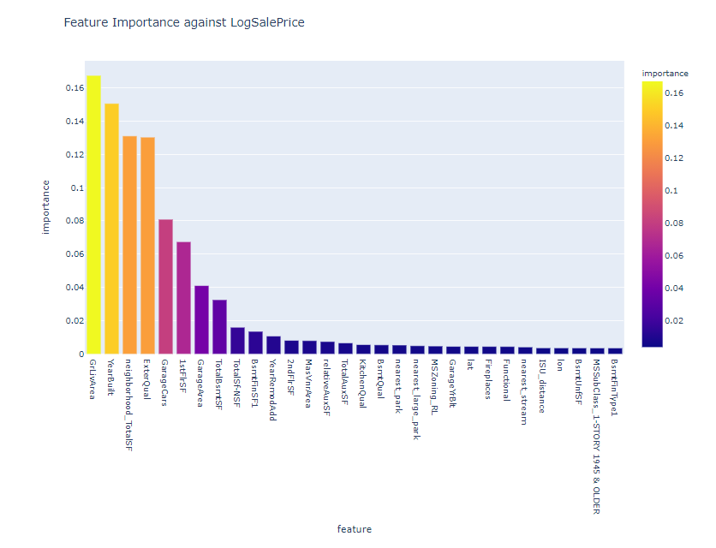
Top 30 Important features from Random Forest Regression.
Mean cross-validated R^2 score of the best estimator: 0.777
R^2 test score for best estimator: 0.829

Slide 29
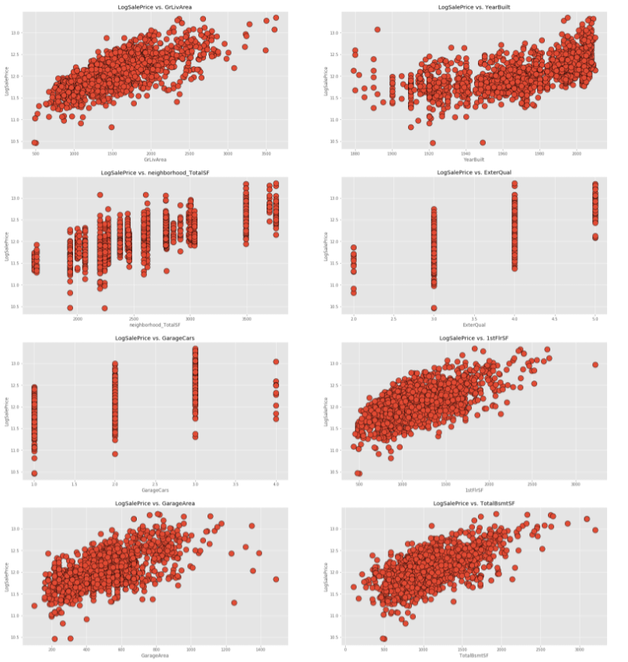
Scatterplots of the top 8 features by importance.
Linear relationship with LogSalePrice is evident. So a linear model should be appropriate.
However multicollinearity issues may be an issue. So further feature selection is needed.

Slide 30
Filtering features based on statistical significance.
-> Take top 30 important features from Random Forest
-> Fit Huber Regression model on those features against LogSale Price
-> Filter out features based on corresponding coefficient p-values
-> Refit Huber Model using filtered feature set.
-> Repeat until all coefficients are statistically significant at level 0.05.

Slide 31
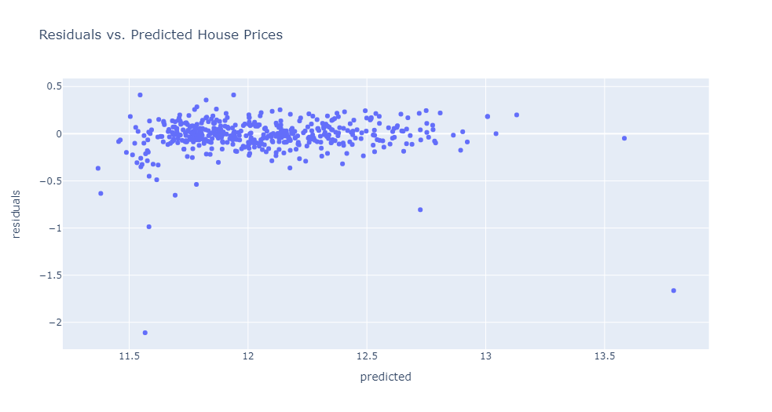
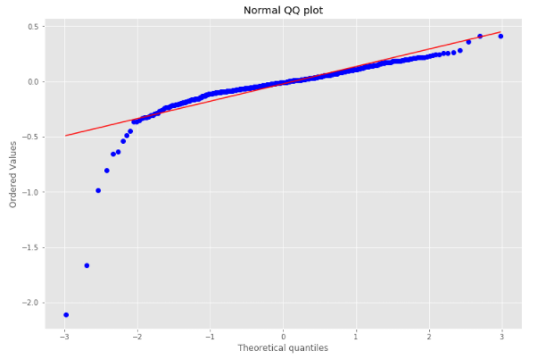
Results after 4 iterations:
We are left with 19 features:
Train R^2: 0.888
Test R^2: 0.785
Year Built, Neighborhood Total SF, Exterior Quality, 1st Floor SF, Garage SF, Year remodeled, 2nd Floor SF, Relative Auxiliary SF, Total Auxiliary SF, Kitchen Quality, Basement Quality, Nearest Park, Nearest Large Park, Fireplaces, Basement Unfinished SF, Basement Finish Type1, MSSubClass 1-Story 1945 & Older, MSZoning RL, and Home Functionality

Slide 32
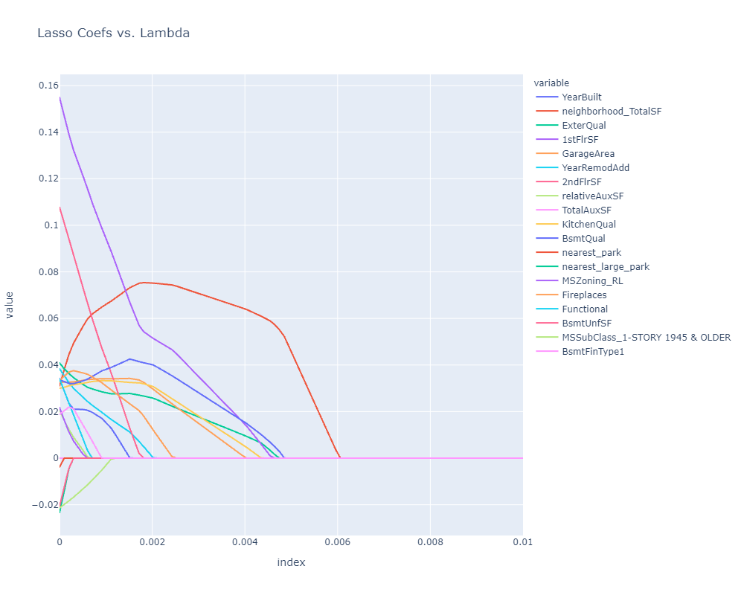
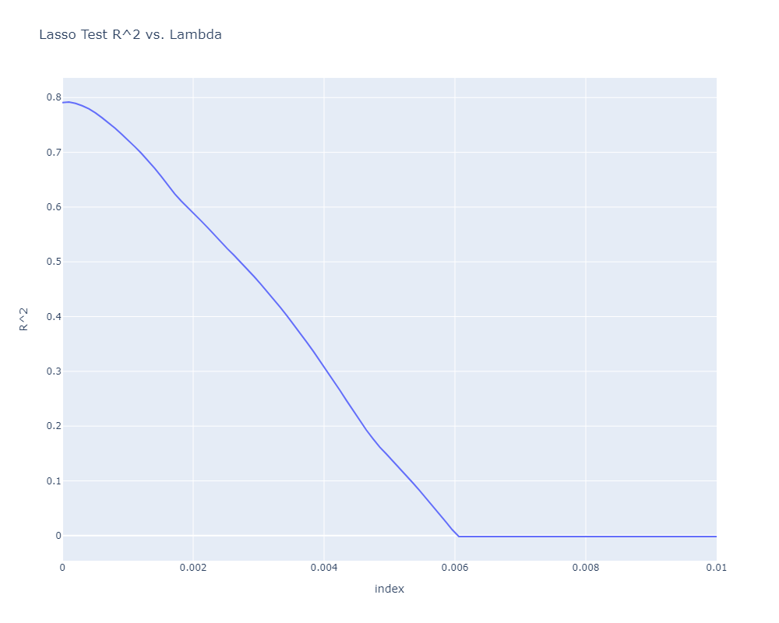
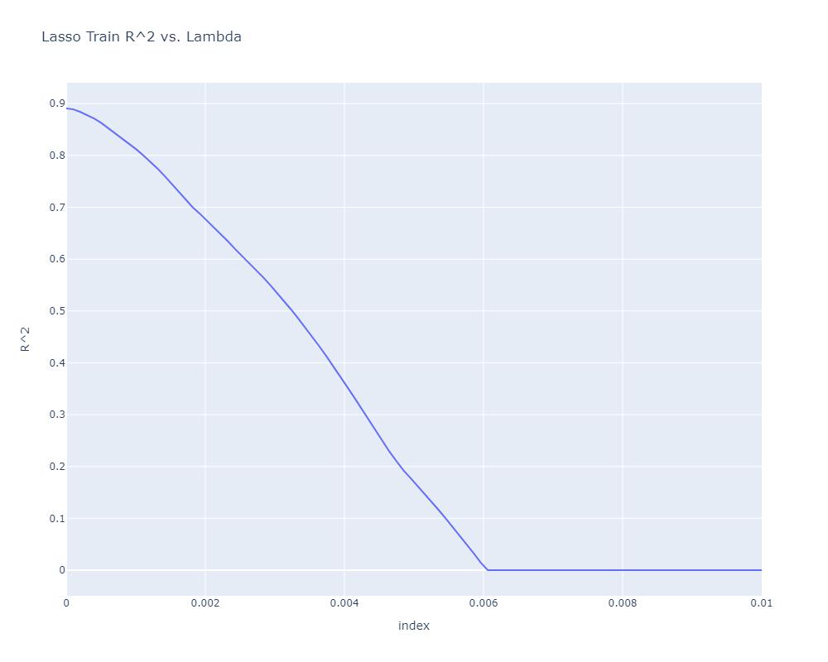
Lasso on Remaining Features

Slide 33
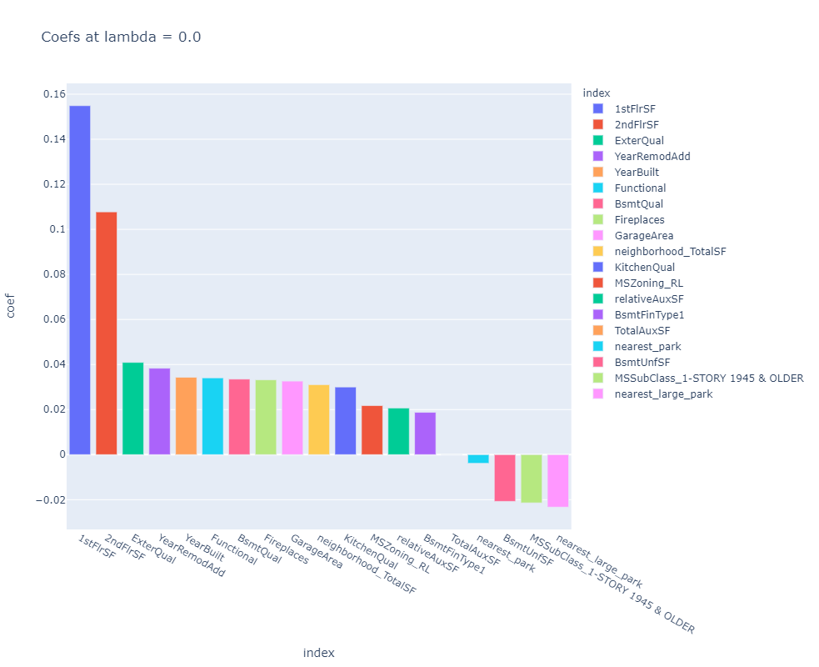
Coefficient breakdown at no regularization.

Slide 34
FUTURE WORK

Slide 35
Continue experimenting with feature engineering.
Connect housing and real estate sets to try and estimate land value over time.
Try to create our own metric for Overall Quality that is correlated with the one provided, but easily explainable.
Implement a live dashboard.

Slide 36
Special Thanks To

Slide 37


NYC DATA SCIENCE
ACADEMY
DATA USA
https://www.kaggle.com/emurphy/ames-iowa-housing-prices-dataset

